Slide 1
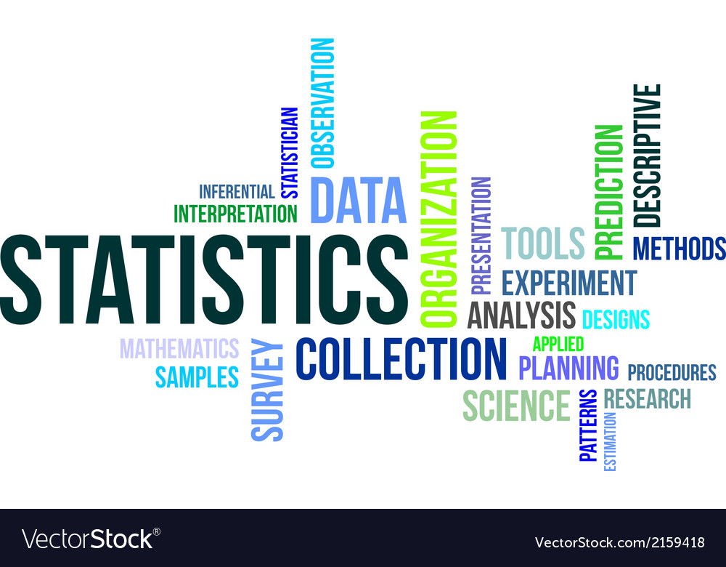
Statistics for Research
What, Why and How

Slide 2
Disclaimer!!!
“There are no stupid questions”
Ask questions!
Be Interactive
Let’s all learn

Slide 3



Before we start…
What is statistics?
Why should you learn statistics?
Has it ever been fun?

Slide 4
Some answers
What is statistics?
Describe, visualize, analyse, interpret from data
Study of randomness/variation
Why should you learn statistics?
Teaches us how to design experiments
How to validate our scientific hypothesis
So that you are not fooled by faulty statistics when you read/do research
Stats is must for biology

Slide 5
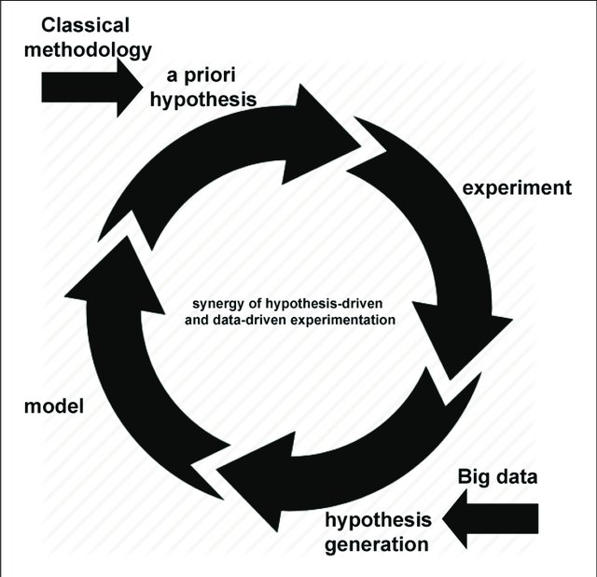
Better question: What is useful?
Research is a constant cycle of hypothesis and data drive experiments
Hypothesis and data are interdependent
Good data => Good hypothesis
Data Analysis
Pattern identification
Good experiment => Good data
Study design
The cycle of research
Huslen et al, Frontiers in Biomedicine, 2019

Slide 6
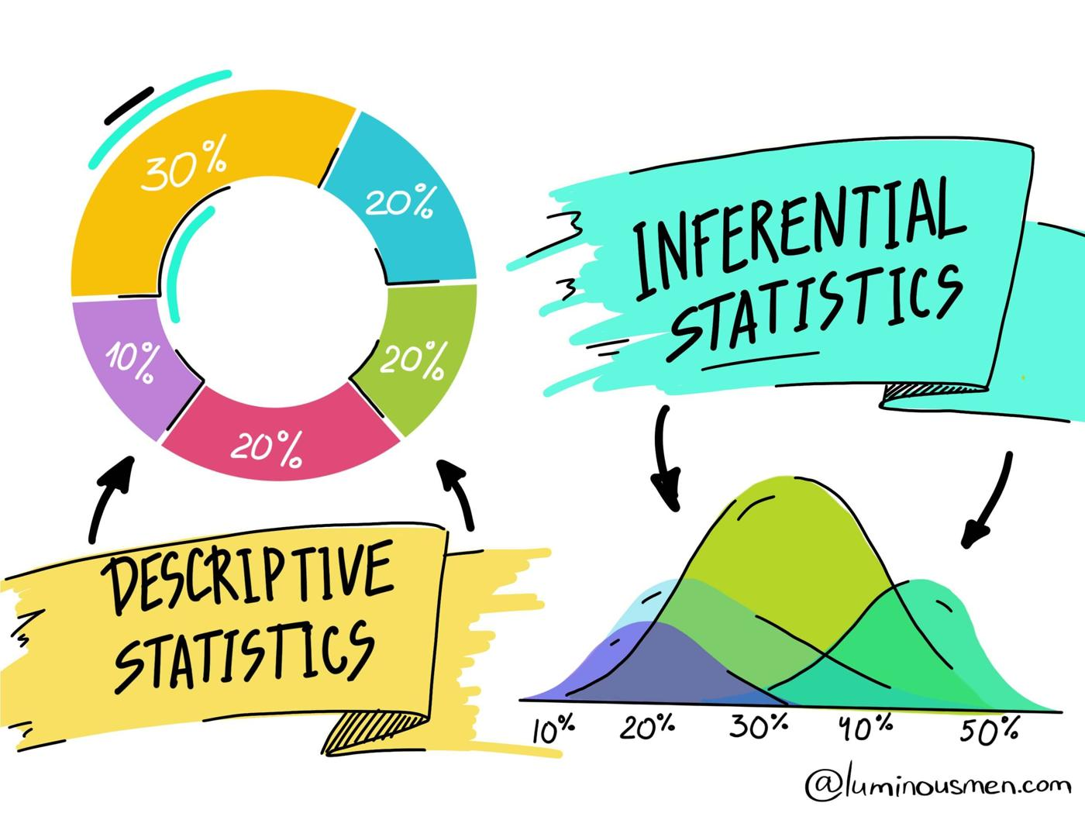
The two parts of statistics
Descriptive Statistics – Hands on session tomorrow
“Measure” Data (Central tendencies, outliers, unique entities, frequencies…)
Visualize data
Identify relations/patterns within data
Generate hypothesis
Inferential Statistics
Generate hypothesis
Test hypothesis
Design experiments
https://luminousmen.com/post/descriptive-and-inferential-statistics

Slide 7

What will be covered in this session?
Concepts needed to understand and perform statistical inference
Randomness and variation (better known as errors)
Making sense of randomness – distributions and measures
“Statistical significance” – statistical testing and p-value myth
Randomness vs variation – explaining variation (curve fitting, PCA)
All these topics via use cases in biological research

Slide 8
Everything in nature varies
Human body (Blood pressure, Blood sugar, Heart-beat, Height, weight, color…)
Weather (air speed and direction, humidity, temperature etc)
What else do you know that is not a fixed quantity?

Slide 9
Three types of variations
Deterministic variation – the change observed is predictable
Change in the speed of a bike
Change in the trajectory of a ball after hitting a wall
Most of engineered technology
Natural forces(?)
Random variation – the change is entirely unpredictable
Radioactive decay
Transcriptional bursting
Series of videos one will watch when they enter the youtube rabbit hole
A combination of both ***
Statistics is a way to deal with variation, whether or not you know the cause

Slide 10
Measuring and estimating variation

Slide 11
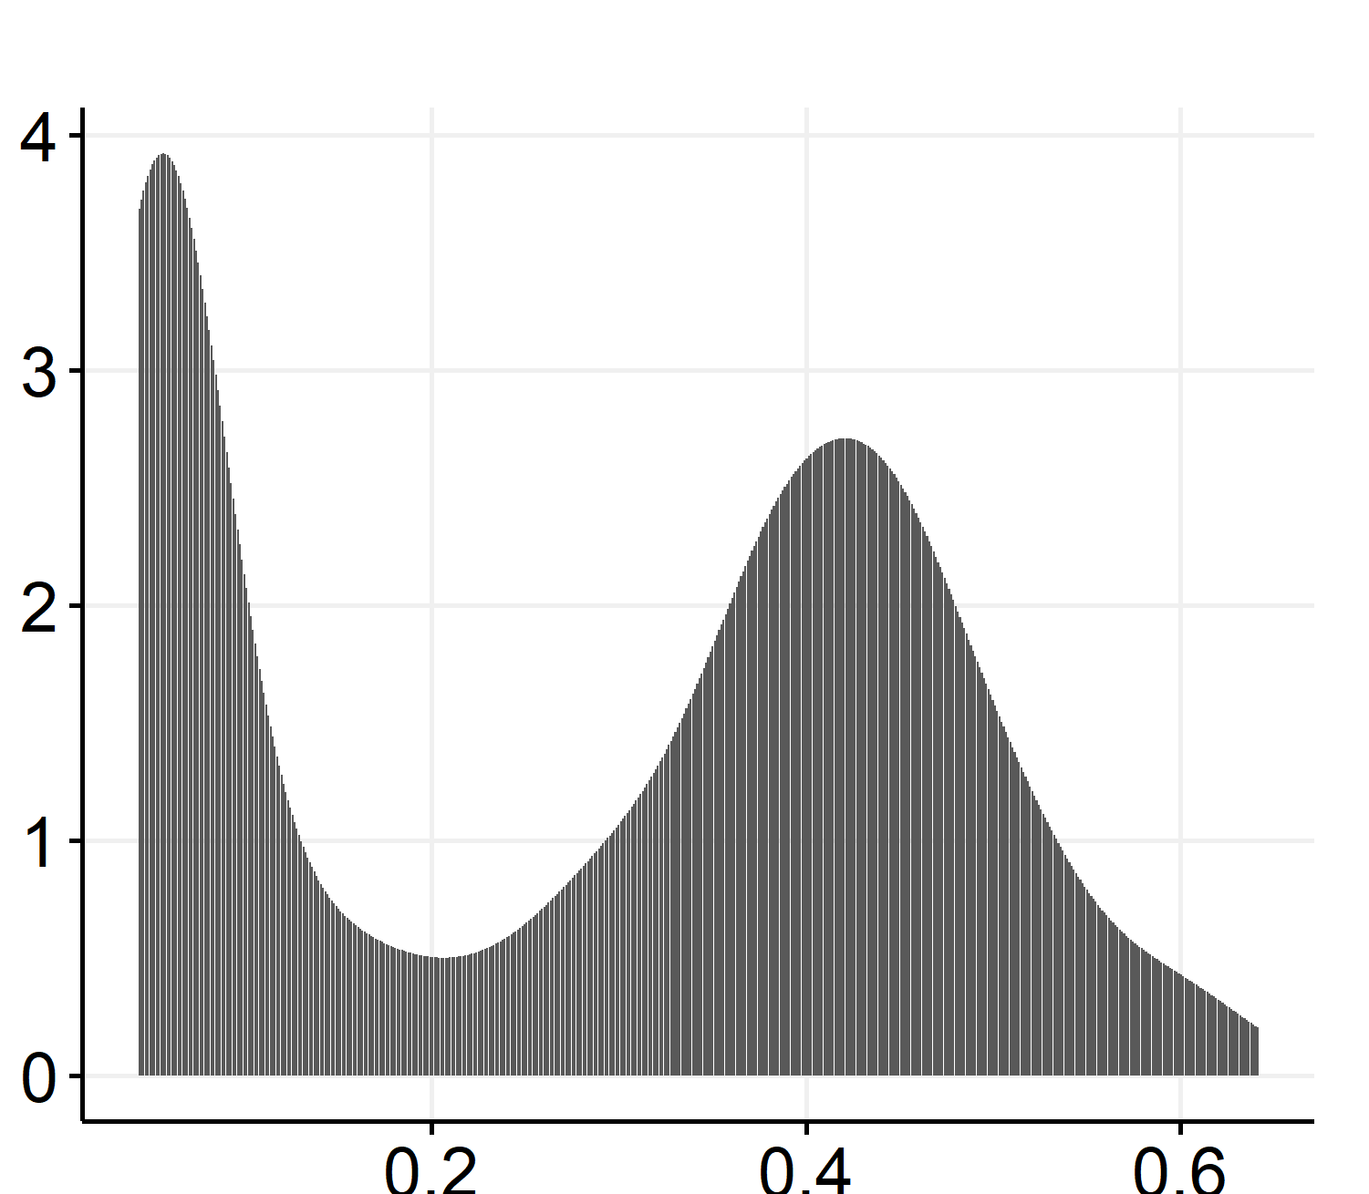
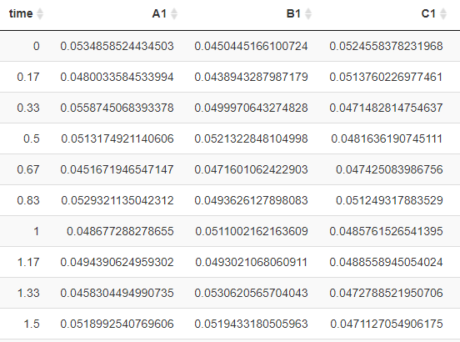
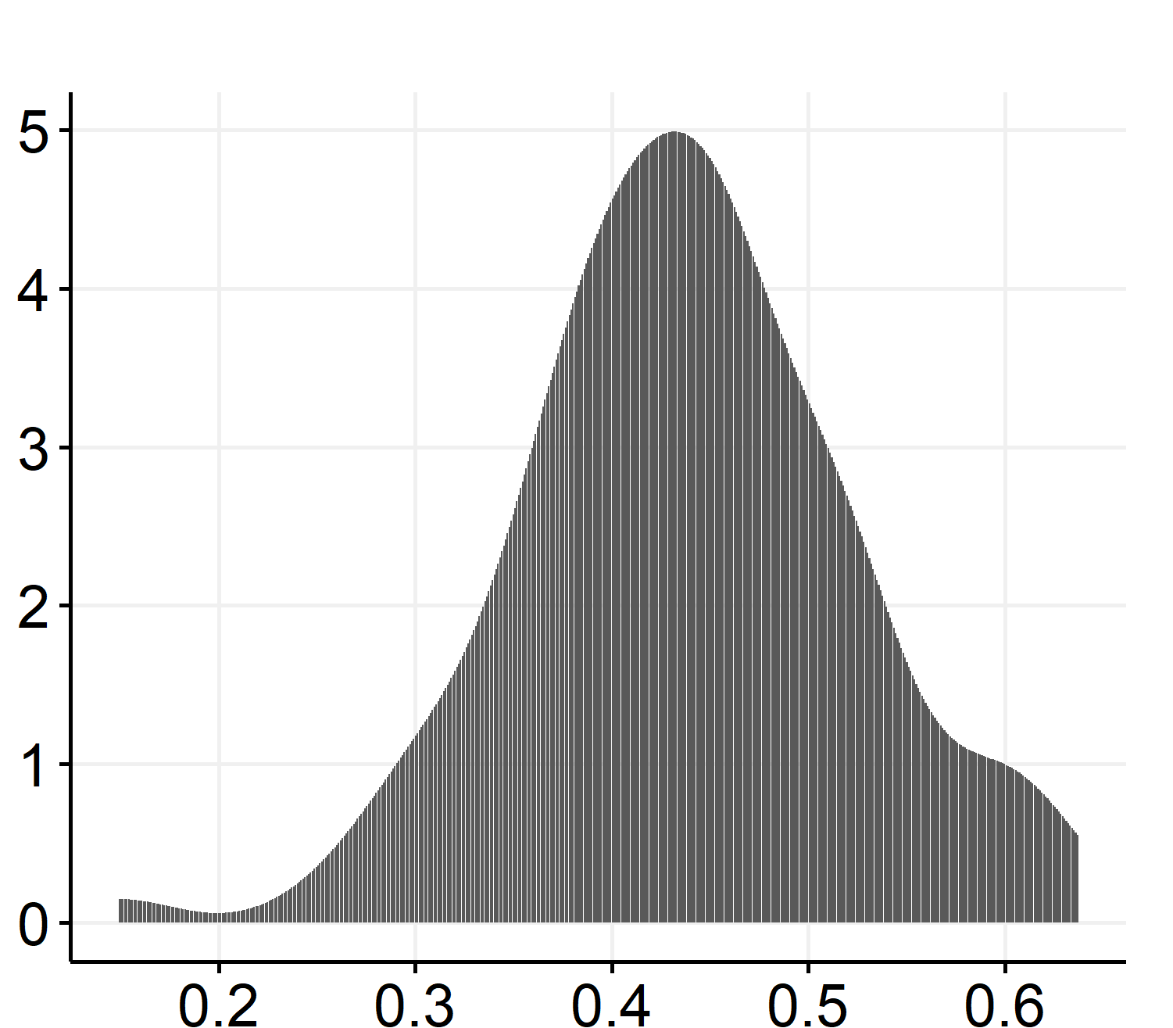
Distributions
Density distribution of all replicates at all time points
OD
Density distribution of all replicates at time =1.5 days. Notice the variation has now reduced!
Time (days)
Bacteria Density, multiple replicates
OD
Notes:
Each distribution gives us different information.

Slide 12
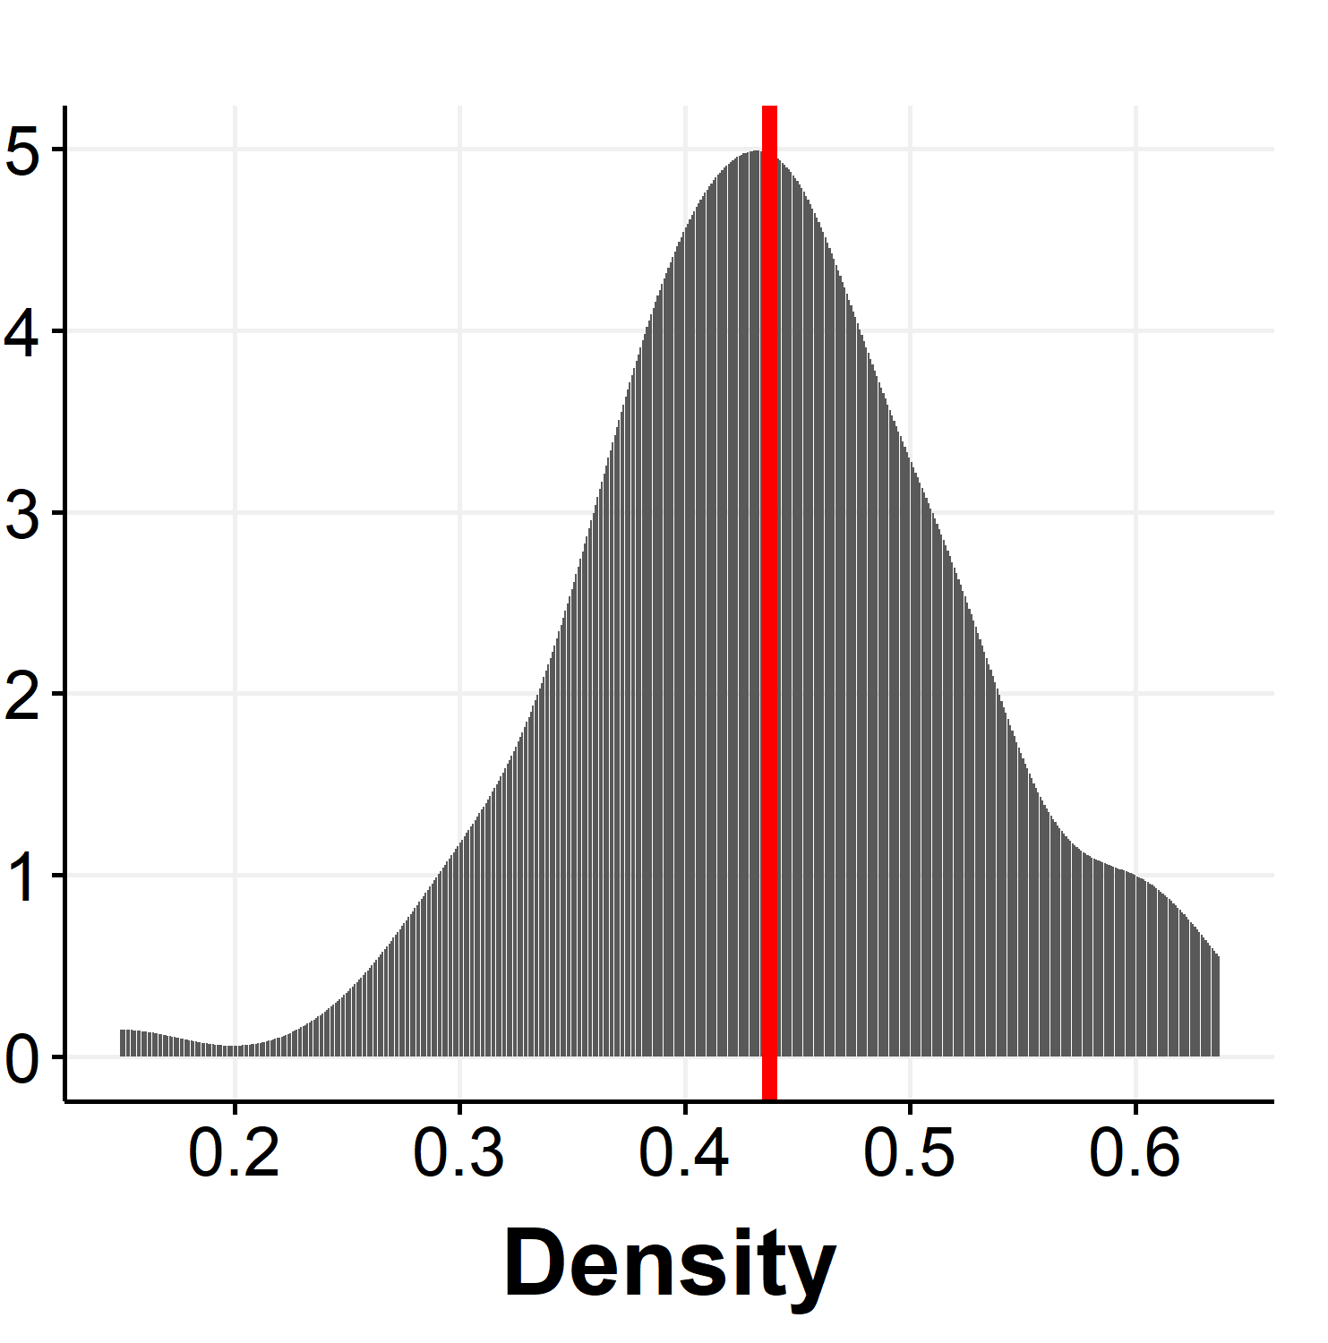
Distribution parameters (recap from yesterday)
Mean
AKA expectation
1st moment
On an average…
Similarly, Standard deviation/variance
From second moment
Measure of variation around the mean
Higher order moments
Do these measures always work?

Slide 13
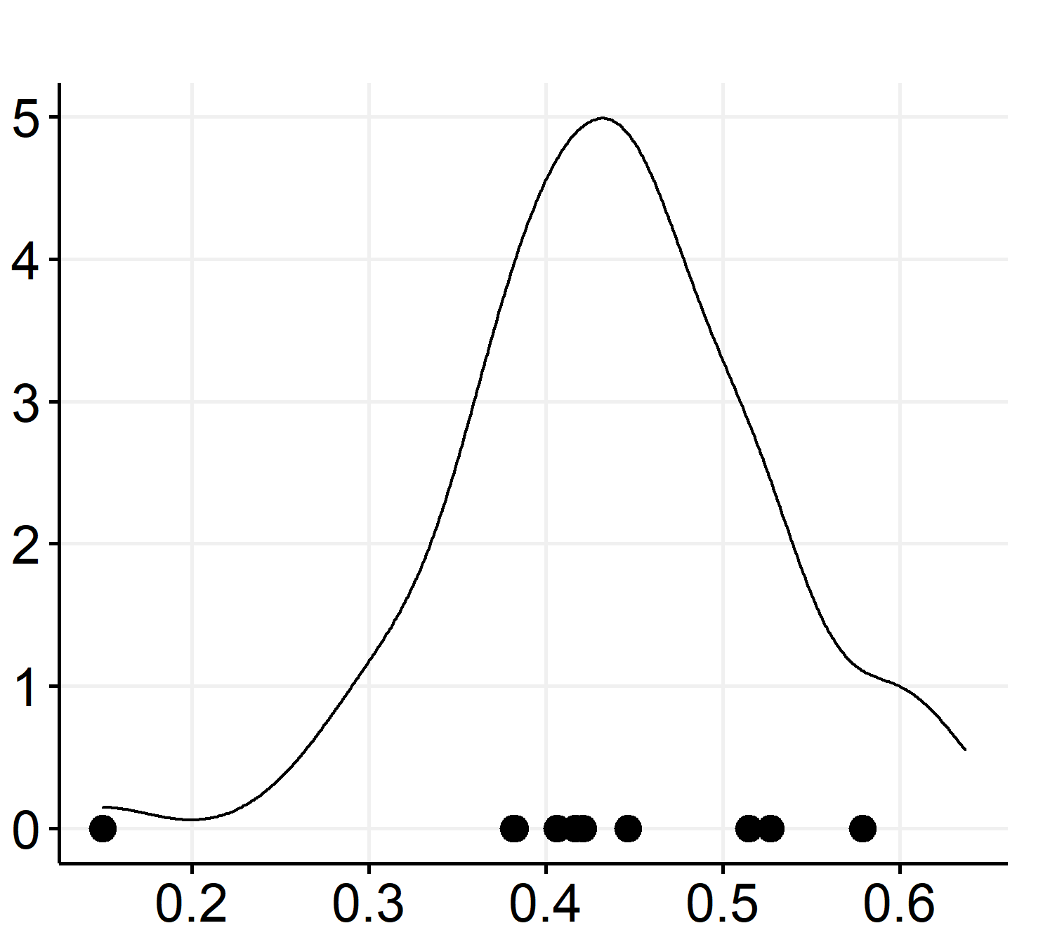
Population vs Sample
Population distribution
Population: Collection of all existing elements/things that are “reasonably” similar to the element/thing under study.
For bacteria, the same species? Same strain?
Similarity is defined by the user
Sample: A subset of the population
Measured during the experiment
Sample
0. | Mean | Standard Deviation
Population | 0.438 | 0.084
Sample | 0.42, 0.49, 0.53 | 0.04, 0.09, 0.12
Population measures need to be estimated from sample to understand the system

Slide 14
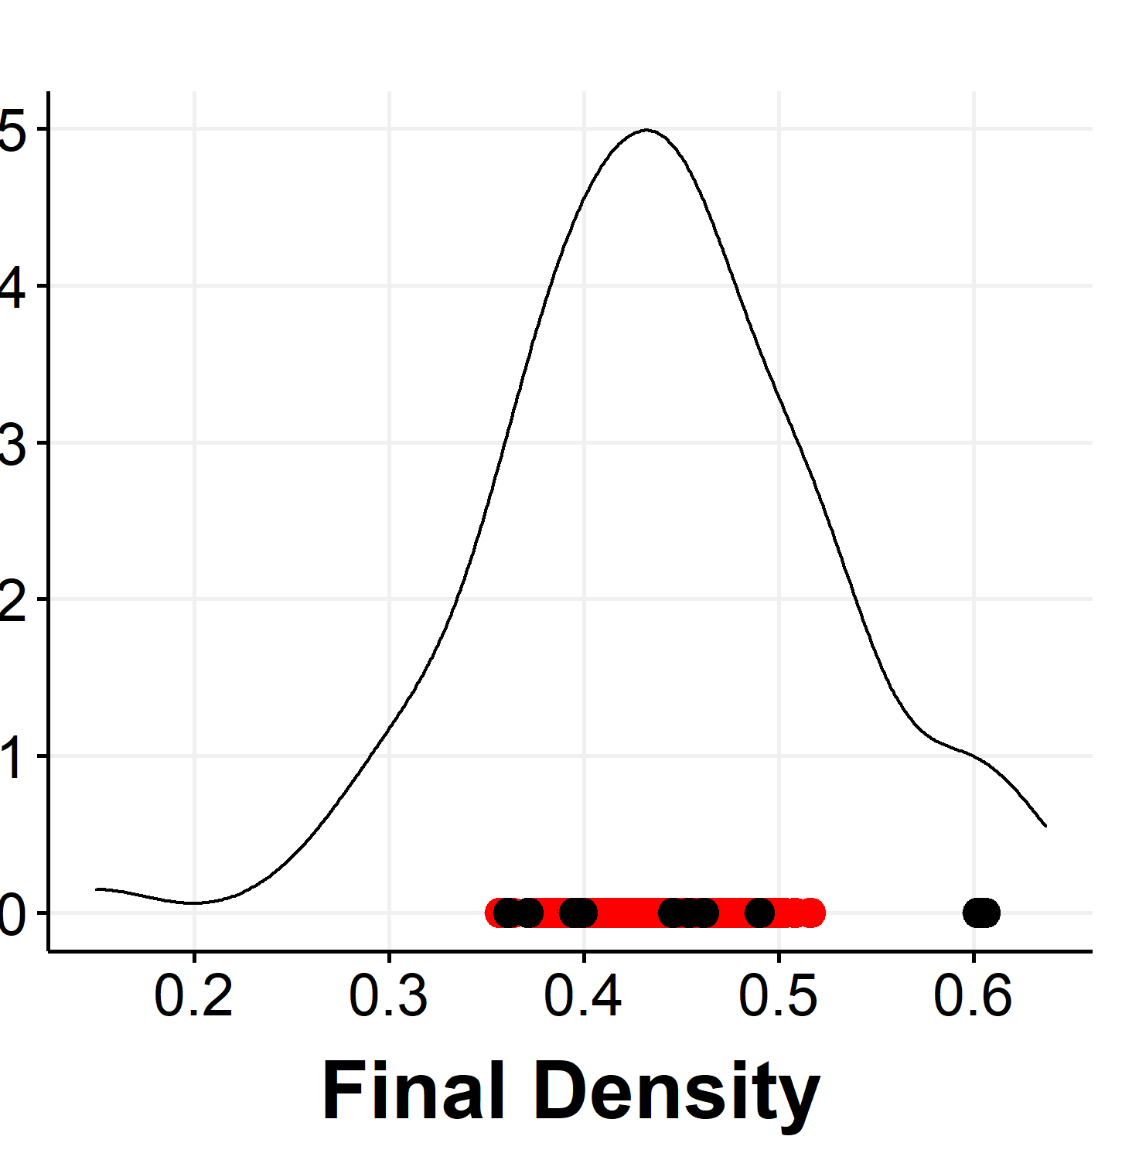
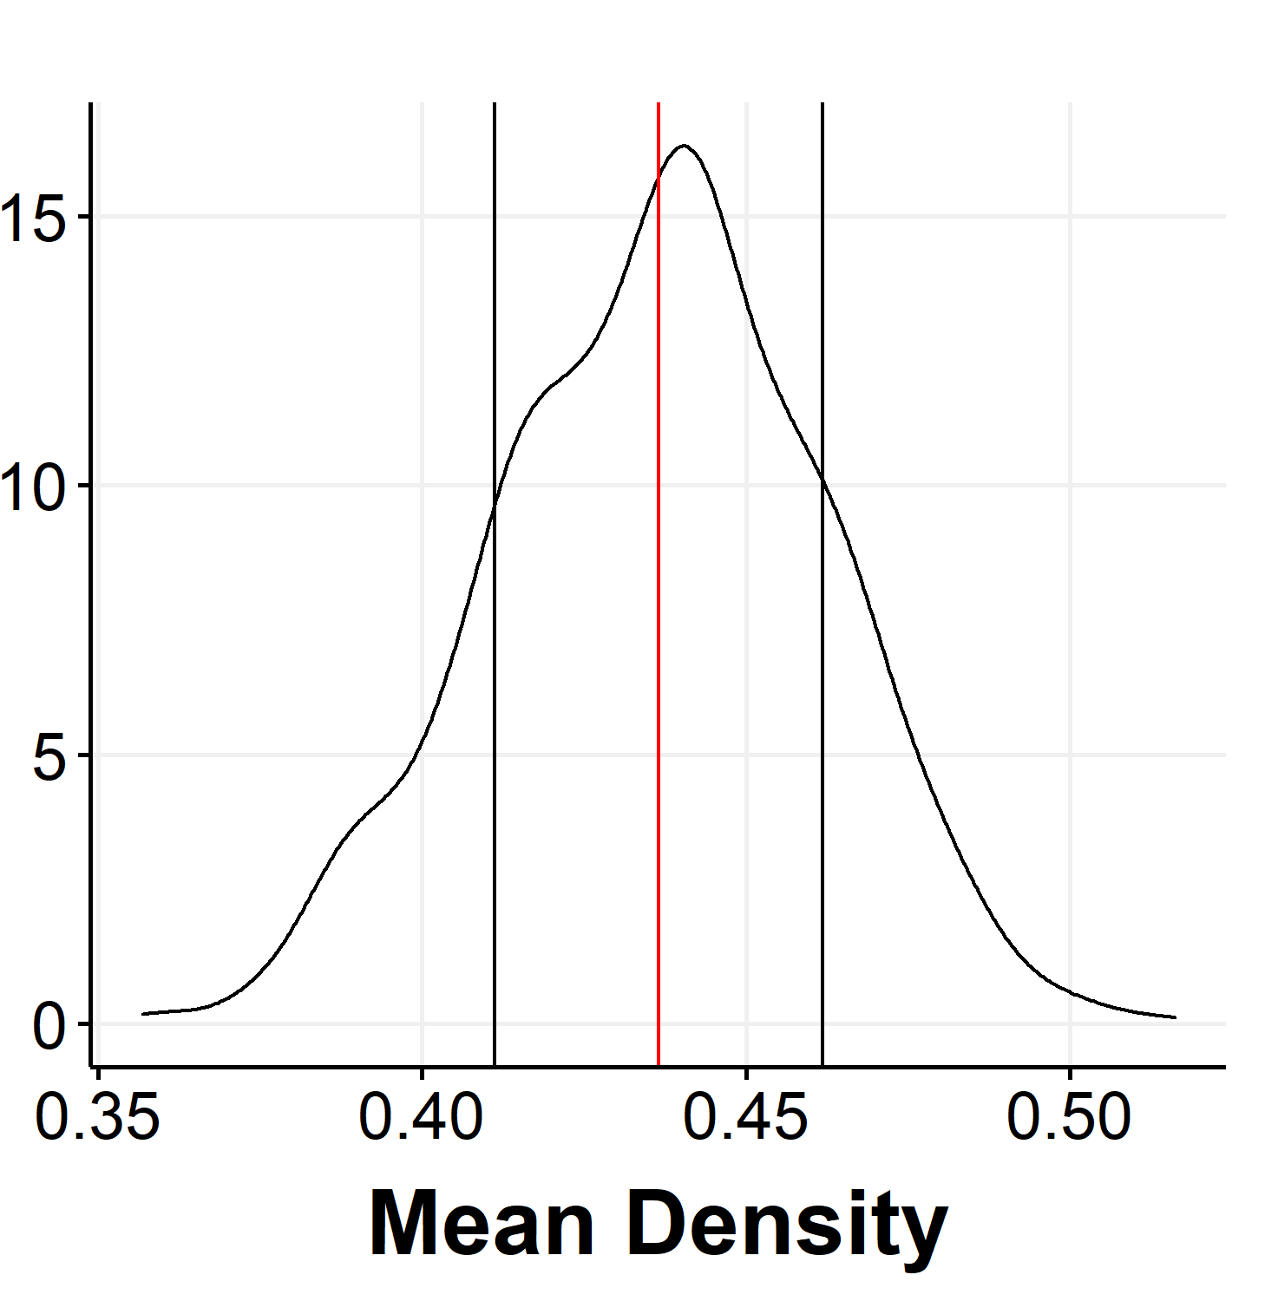
Estimating population parameters
We need – population mean and standard deviation
We have – sample measures
What if we take multiple samples?
Standard error of Mean
Single sample Means of Samples
Distribution of means is more concentrated around the population mean!!!

Slide 15
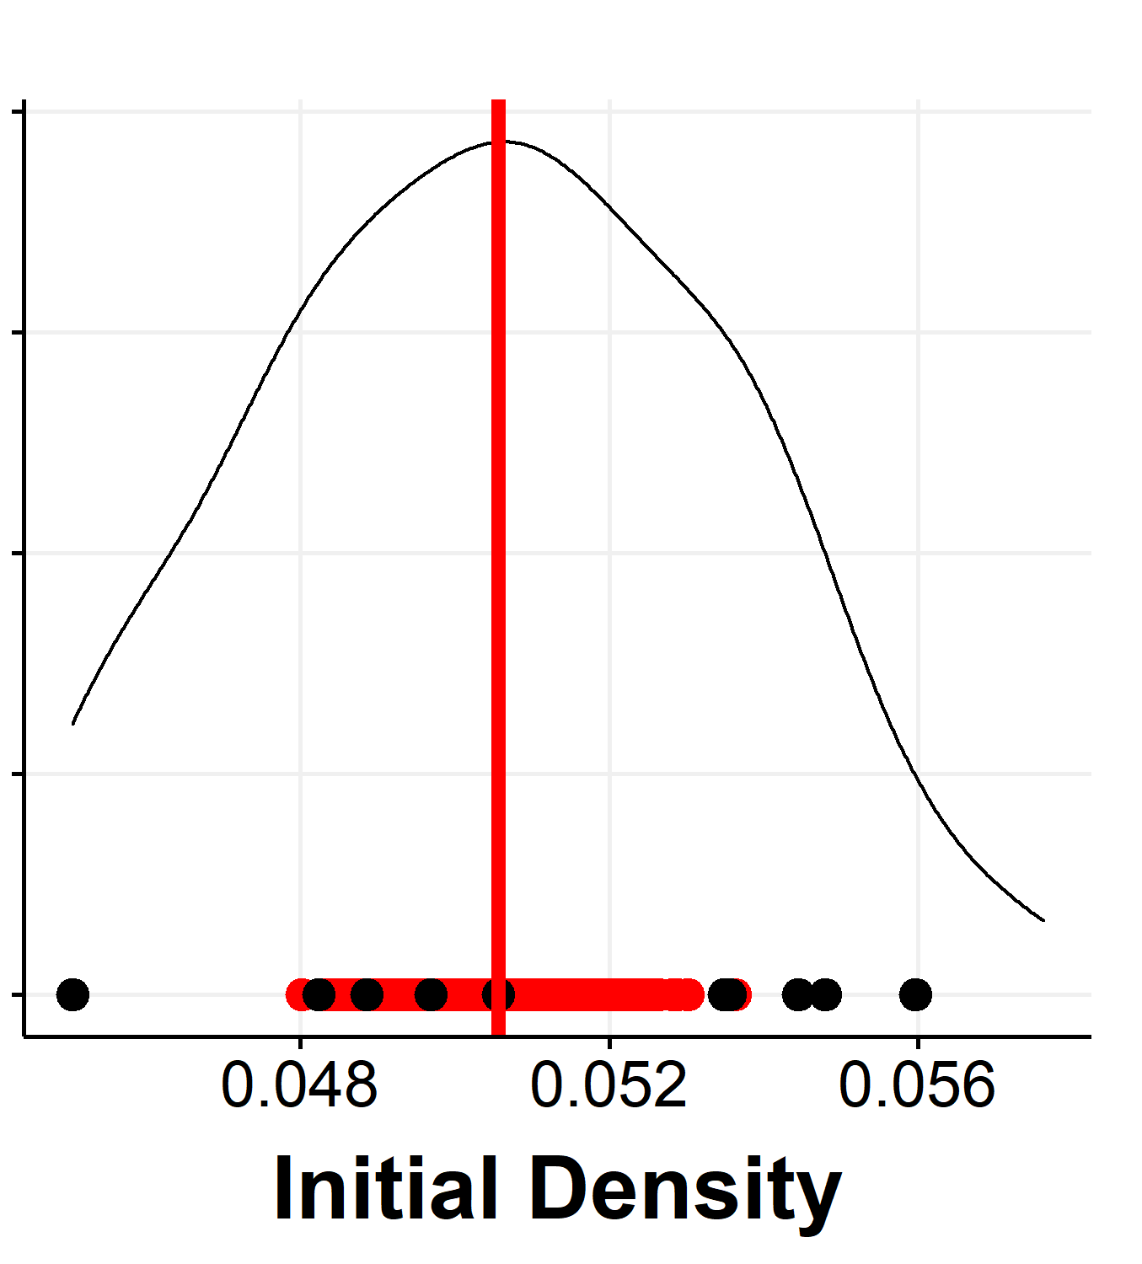
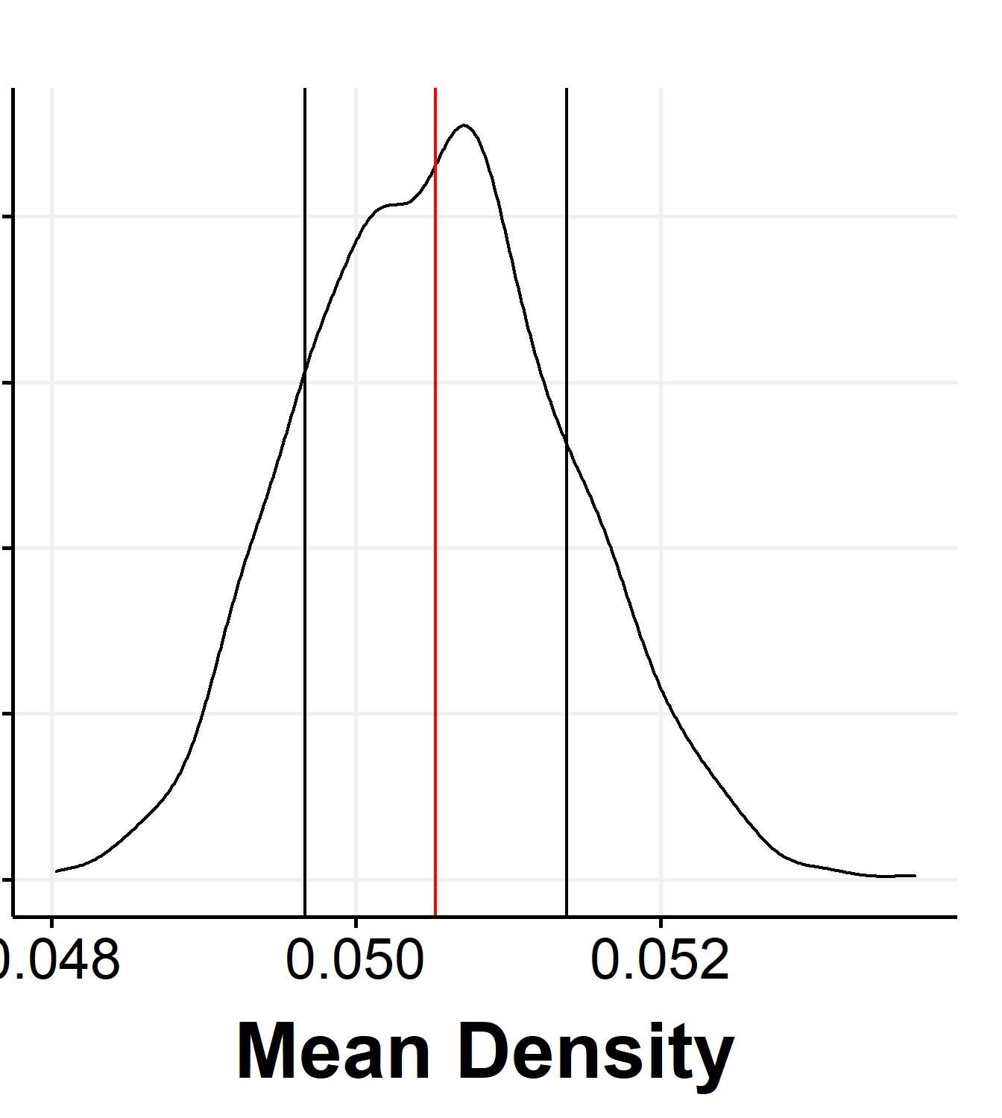
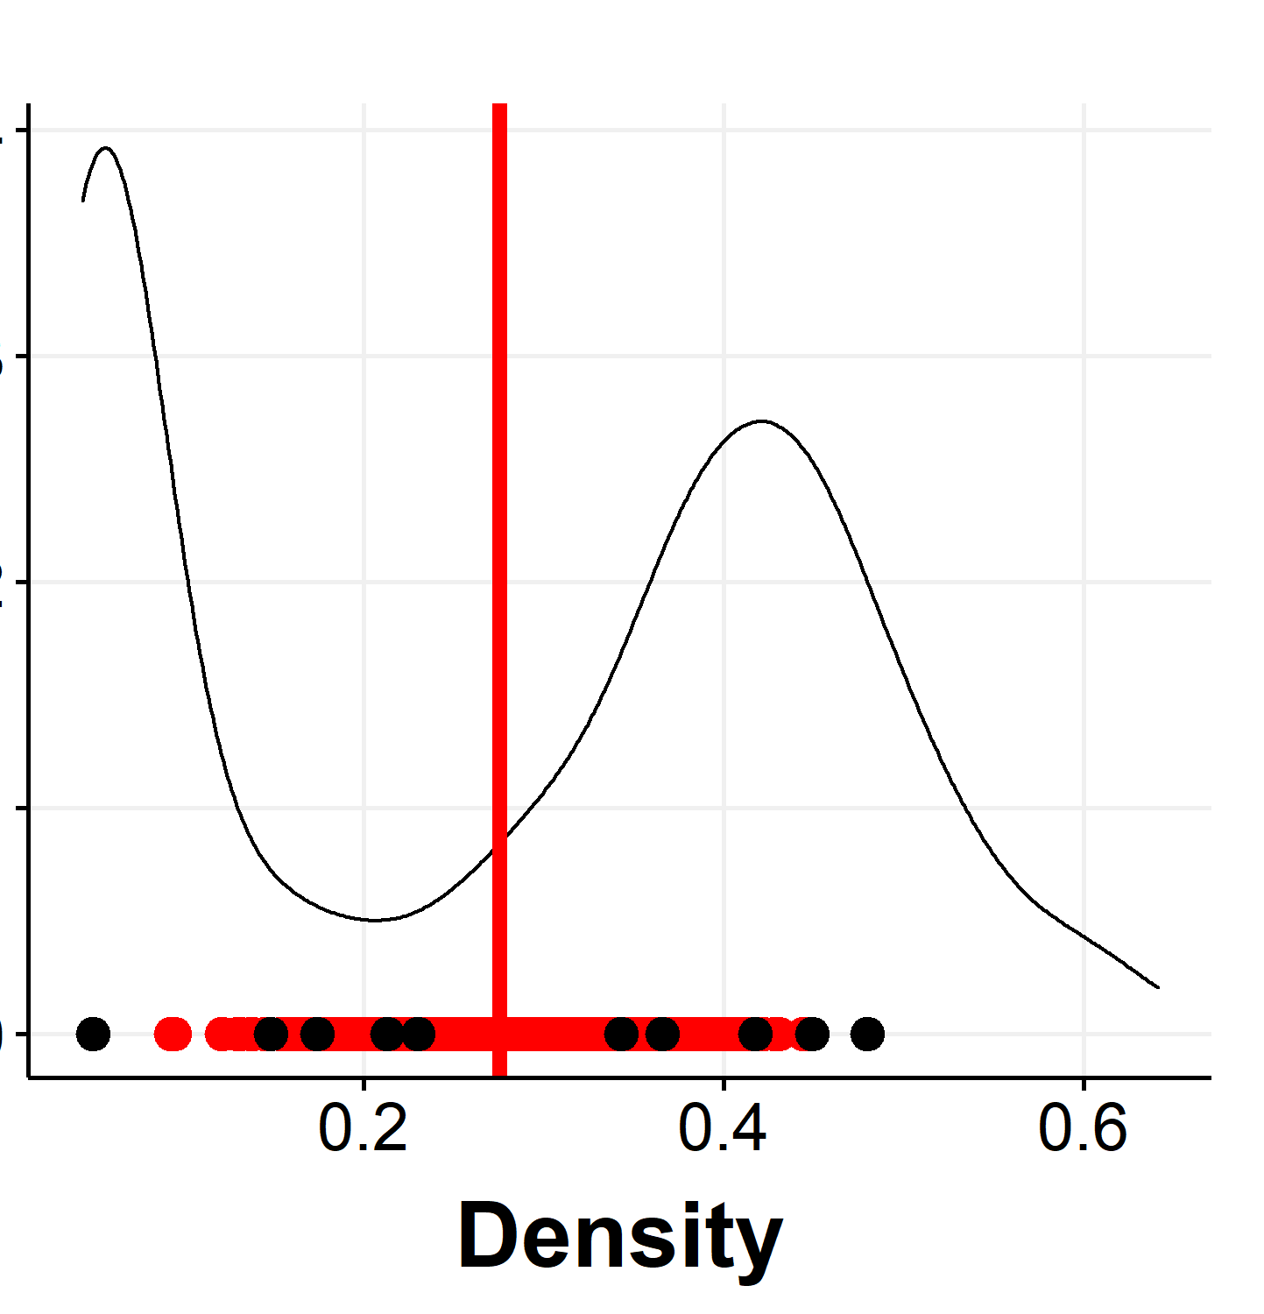
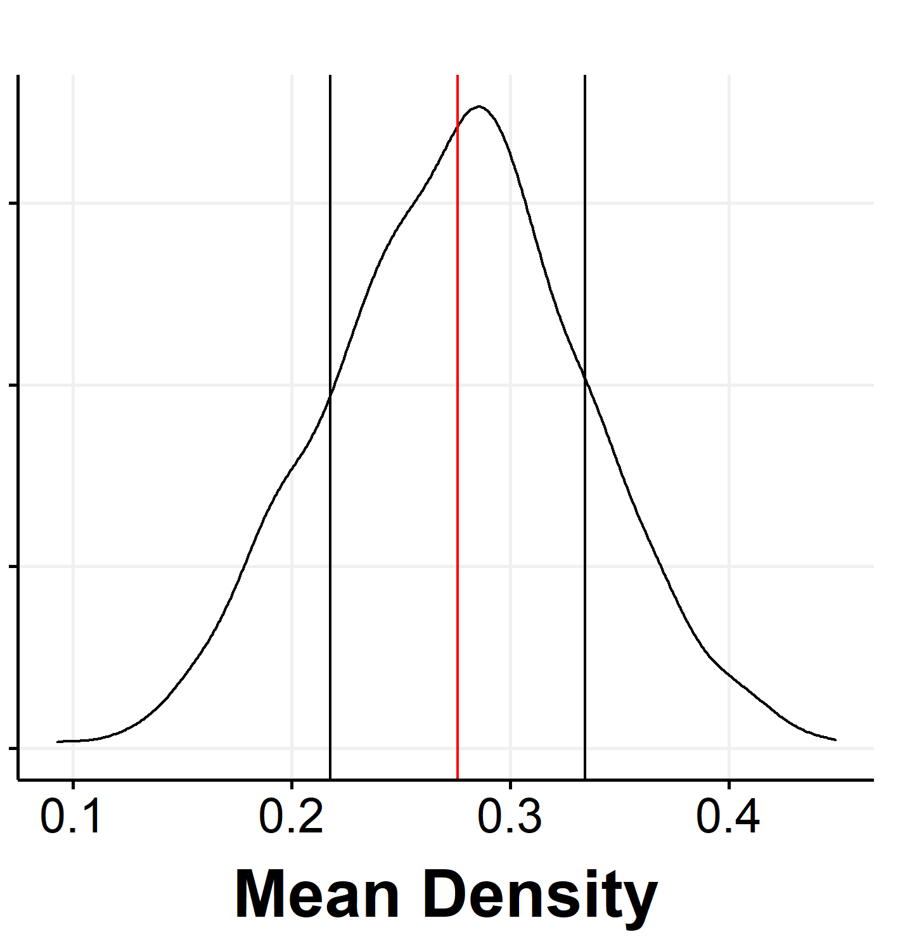
Estimating population parameters (contd…)
Distribution of means is more concentrated around the population mean (notice the x-axes)
Irrespective of the population distribution, the mean has a gaussian distribution!!!
Central Limit Theorm!!!
Mean of sample means always follows normal distribution, with mean = population mean.

Slide 16
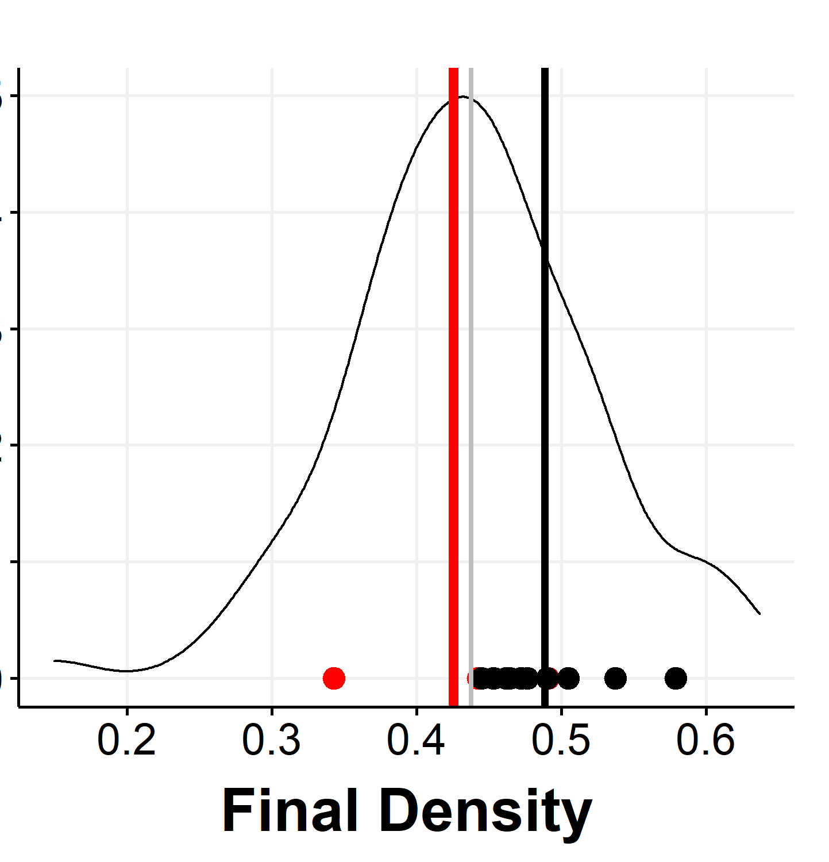
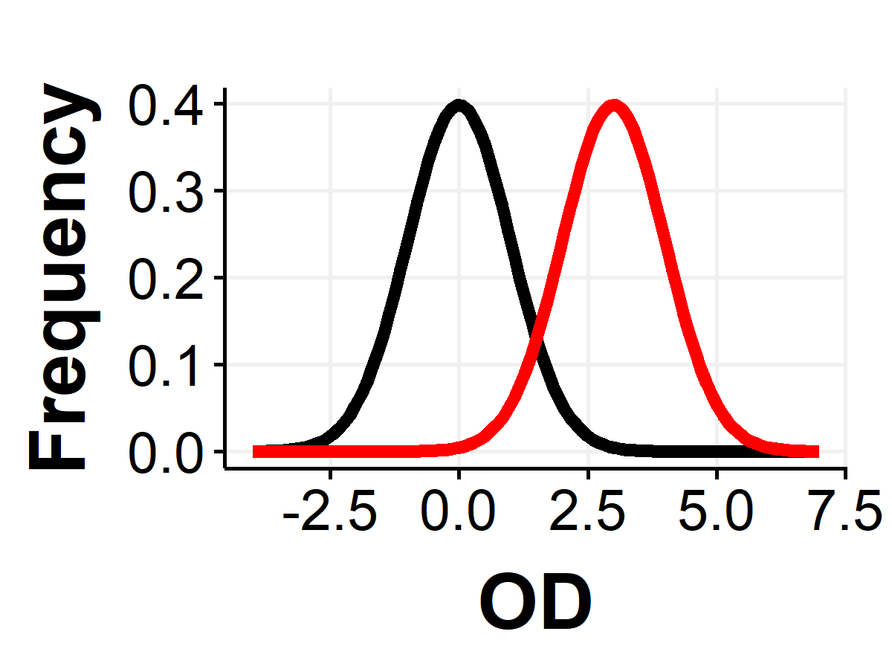
Estimating population parameters (contd…)
Mean of mean of samples ~= Population mean
Can you collect so many samples?
Bacterial culture – sure!
Animal cell culture? – Maybe…
Drug effect on humans??? NO!
Will our samples always give us a good approximation of the mean?
One option: Confidence interval
Mean of means has normal distributions, therefore, the population mean will most likely lie in …

Slide 17
Another option: Bootstrapping (exercise tomorrow)
Get one sample of decent size (>=30: experimental design!)
Resample measurements (OD) from these samples (bootstrapping)
Calculate mean of means
Can also calculate standard error of mean
What is the assumption here?

Slide 18
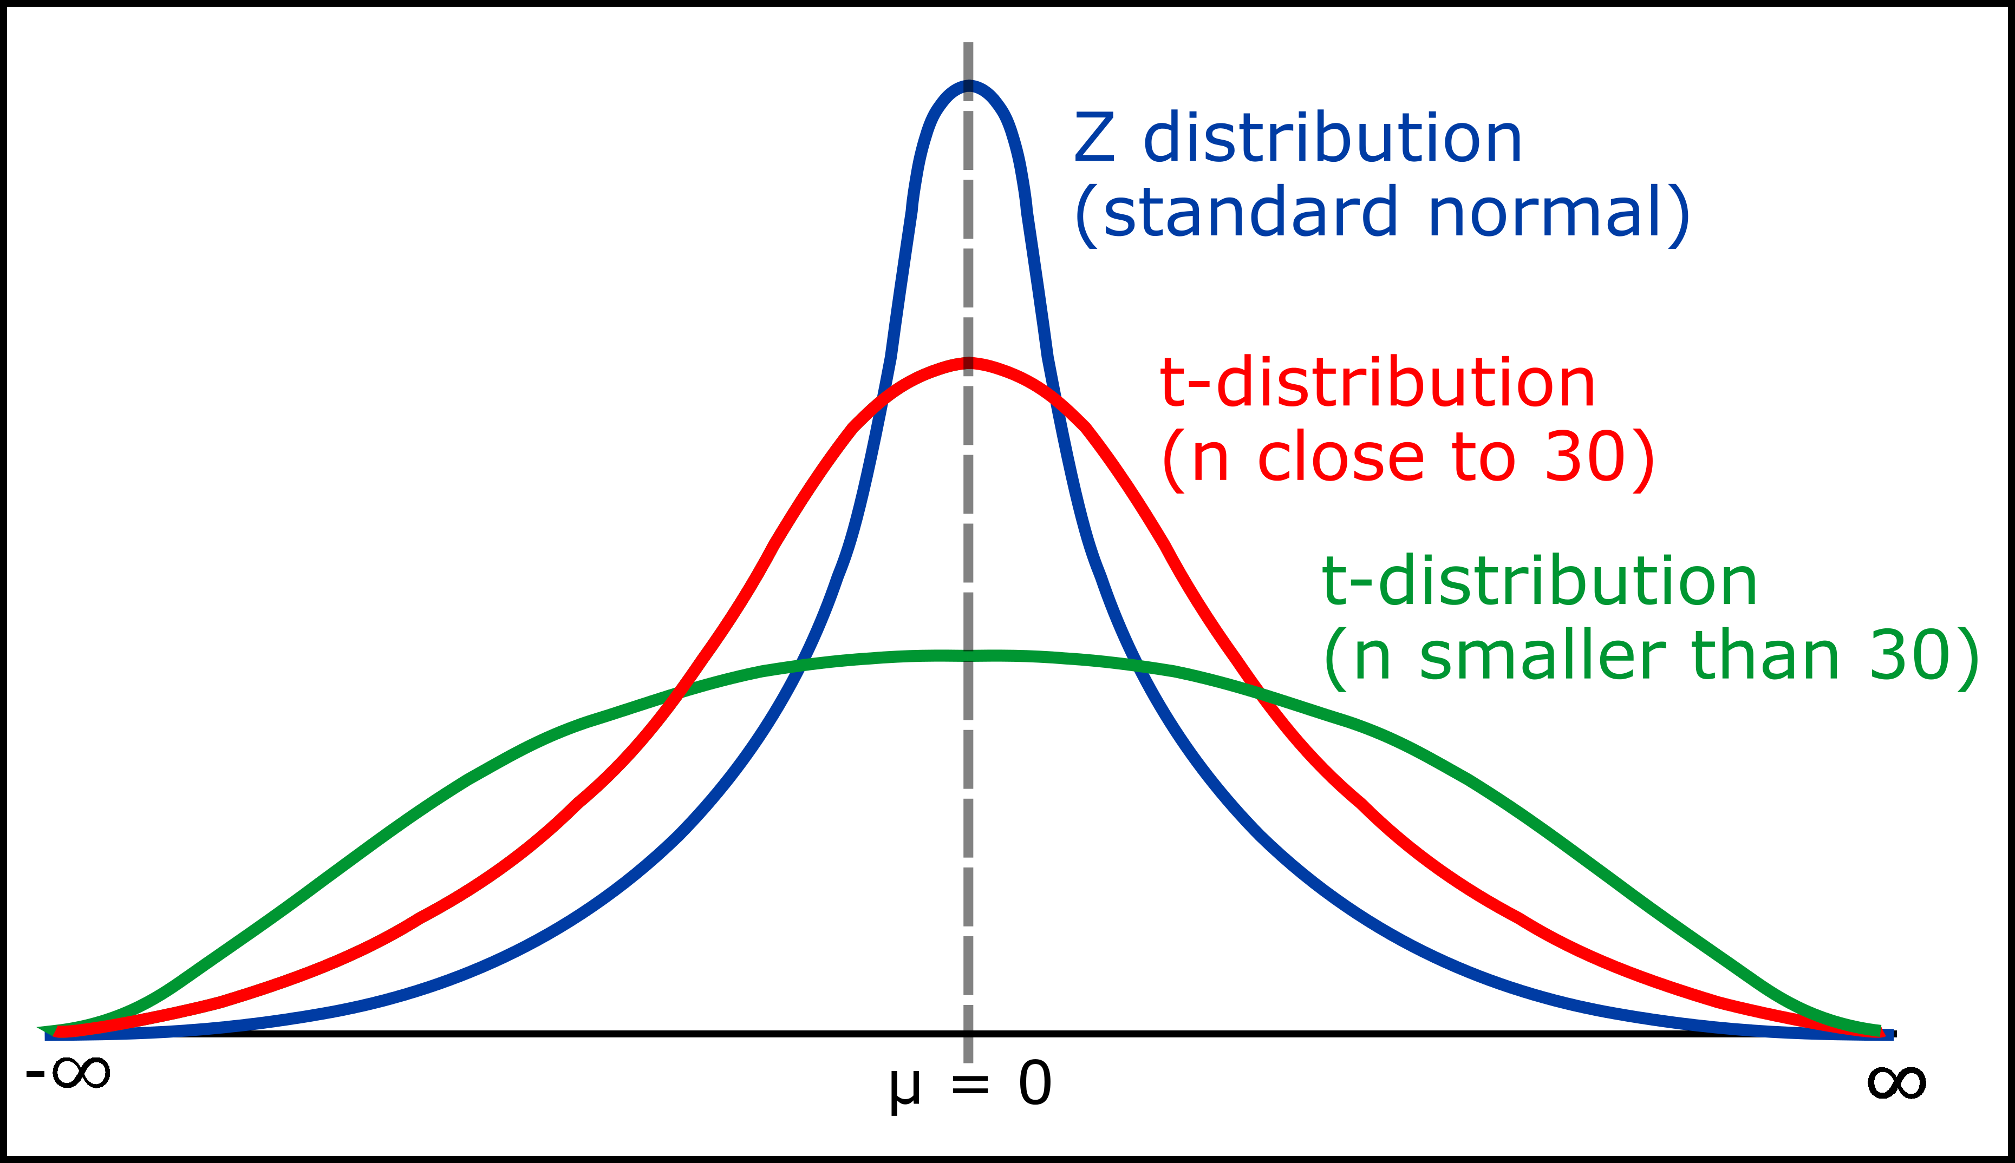
What to do when the sample size is too small? T-distribution
Central Limit Theorem has lesser probability of applying. (Can you predict the sample size at which CLT will apply?)
For small samples, we use t-distribution instead of normal distribution
Normal distribution modified for small samples
Why are the tails fatter?
https://www.geeksforgeeks.org/students-t-distribution-in-statistics/

Slide 19
Open questions
What is population standard deviation?
Sample standard deviation?
Standard error of mean?
Are mean and standard deviation good enough?
What if the distribution is not symmetric about the mean?
What if the distribution has multiple peaks?
Other possible measures: median, mode, quantile range…

Slide 20
Hypothesis testing
Proving that variation has a reason

Slide 21
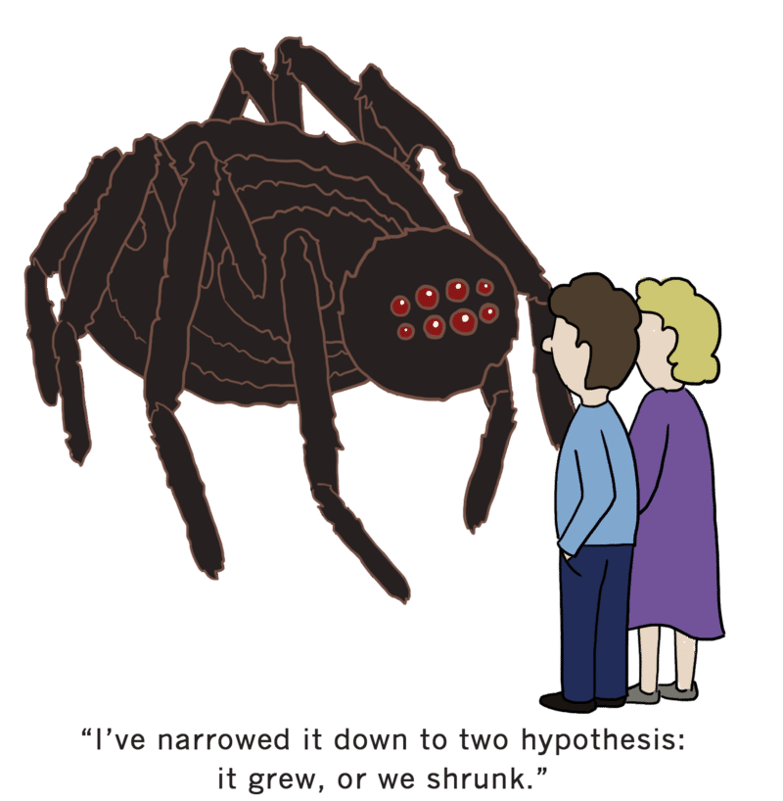
Where do hypotheses come from?
Source of hypothesis
Previous knowledge of mechanisms of the system/similar systems
The bacterium will grow well at 37 degrees because other bacteria do
The bacterium will grow well at 38 degrees as opposed to 40 degrees
Previously available data
The doubling time during exponential growth will be close to 20 minutes, which is the doubling time of a similar bacterium
Pure guesswork
Bacteria will not grow at 10 degrees
The characteristic for a hypothesis : must be disprovable

Slide 22
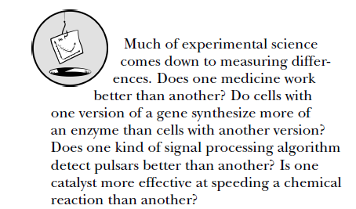
What do hypotheses look like?
General structure: By adding “x” to the system, “y” effect will happen.
If temperature is increased by 5 degrees, bacterial growth goes down
If drug is added, duration of population survival will increase
If an enhancer is added, protein levels will increase
Statistics done wrong, The woefully completer guide, Alex Reinhart

Slide 23
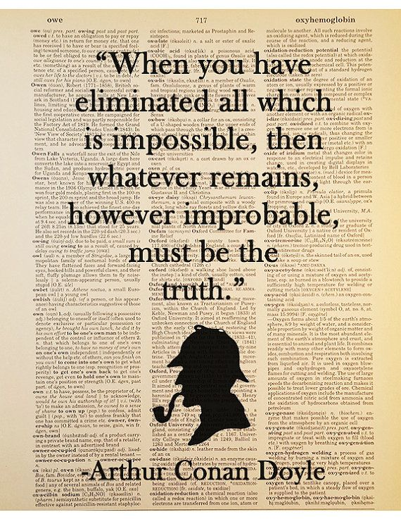
How to confirm our hypothesis?
The scientific method – eliminating all possibilities except the one stated in the hypothesis
Hypothesis must therefore be disprovable
Therefore, we test the “Null” hypothesis
Null hypothesis: the change “x” does not have any effect on the system
Addition of inhibitor does not change the protein levels

Slide 24
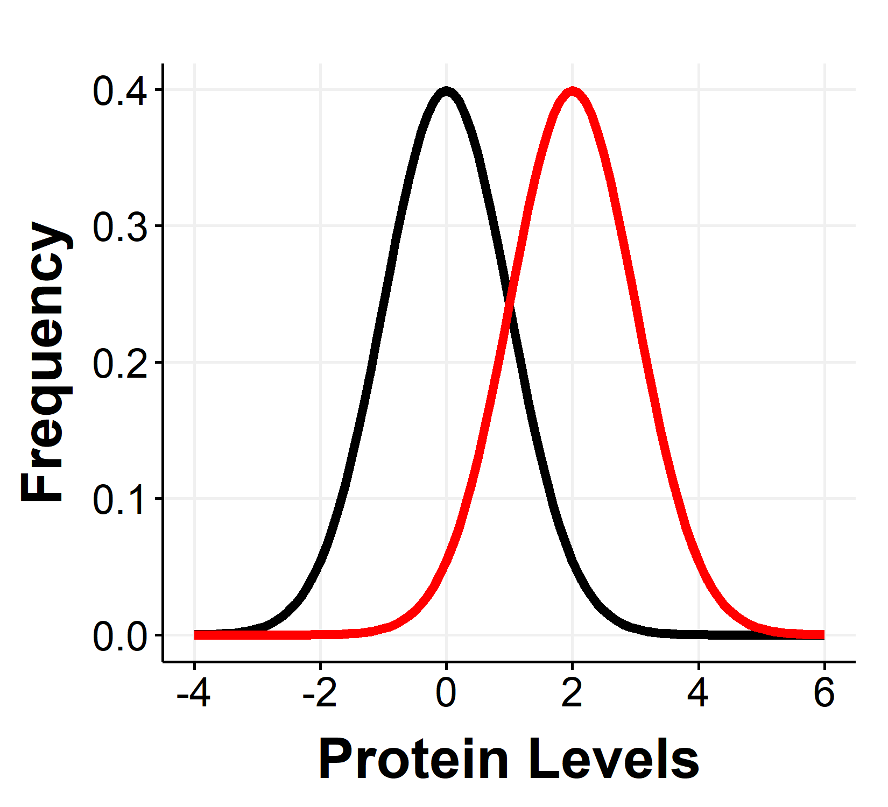
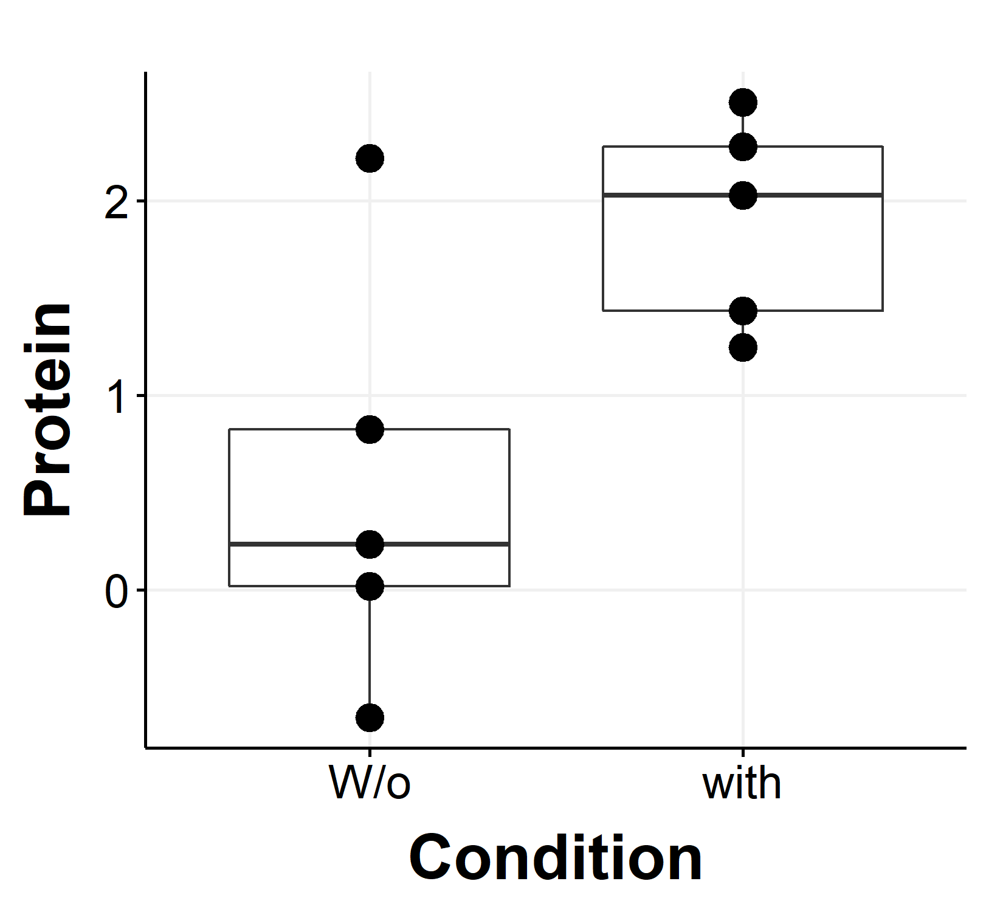
Rejecting the null hypothesis
W/o activator
With activator
Consider the addition of a transcriptional activator to a cell.
Expected effect : increase in protein concentration
Reality : samples from distribution
Expected effect (aka alternative hypothesis) : The two samples do not belong to the same distribution
Null hypothesis: The two samples belong to the same distribution
Aim: Reject the null hypothesis!

Slide 25
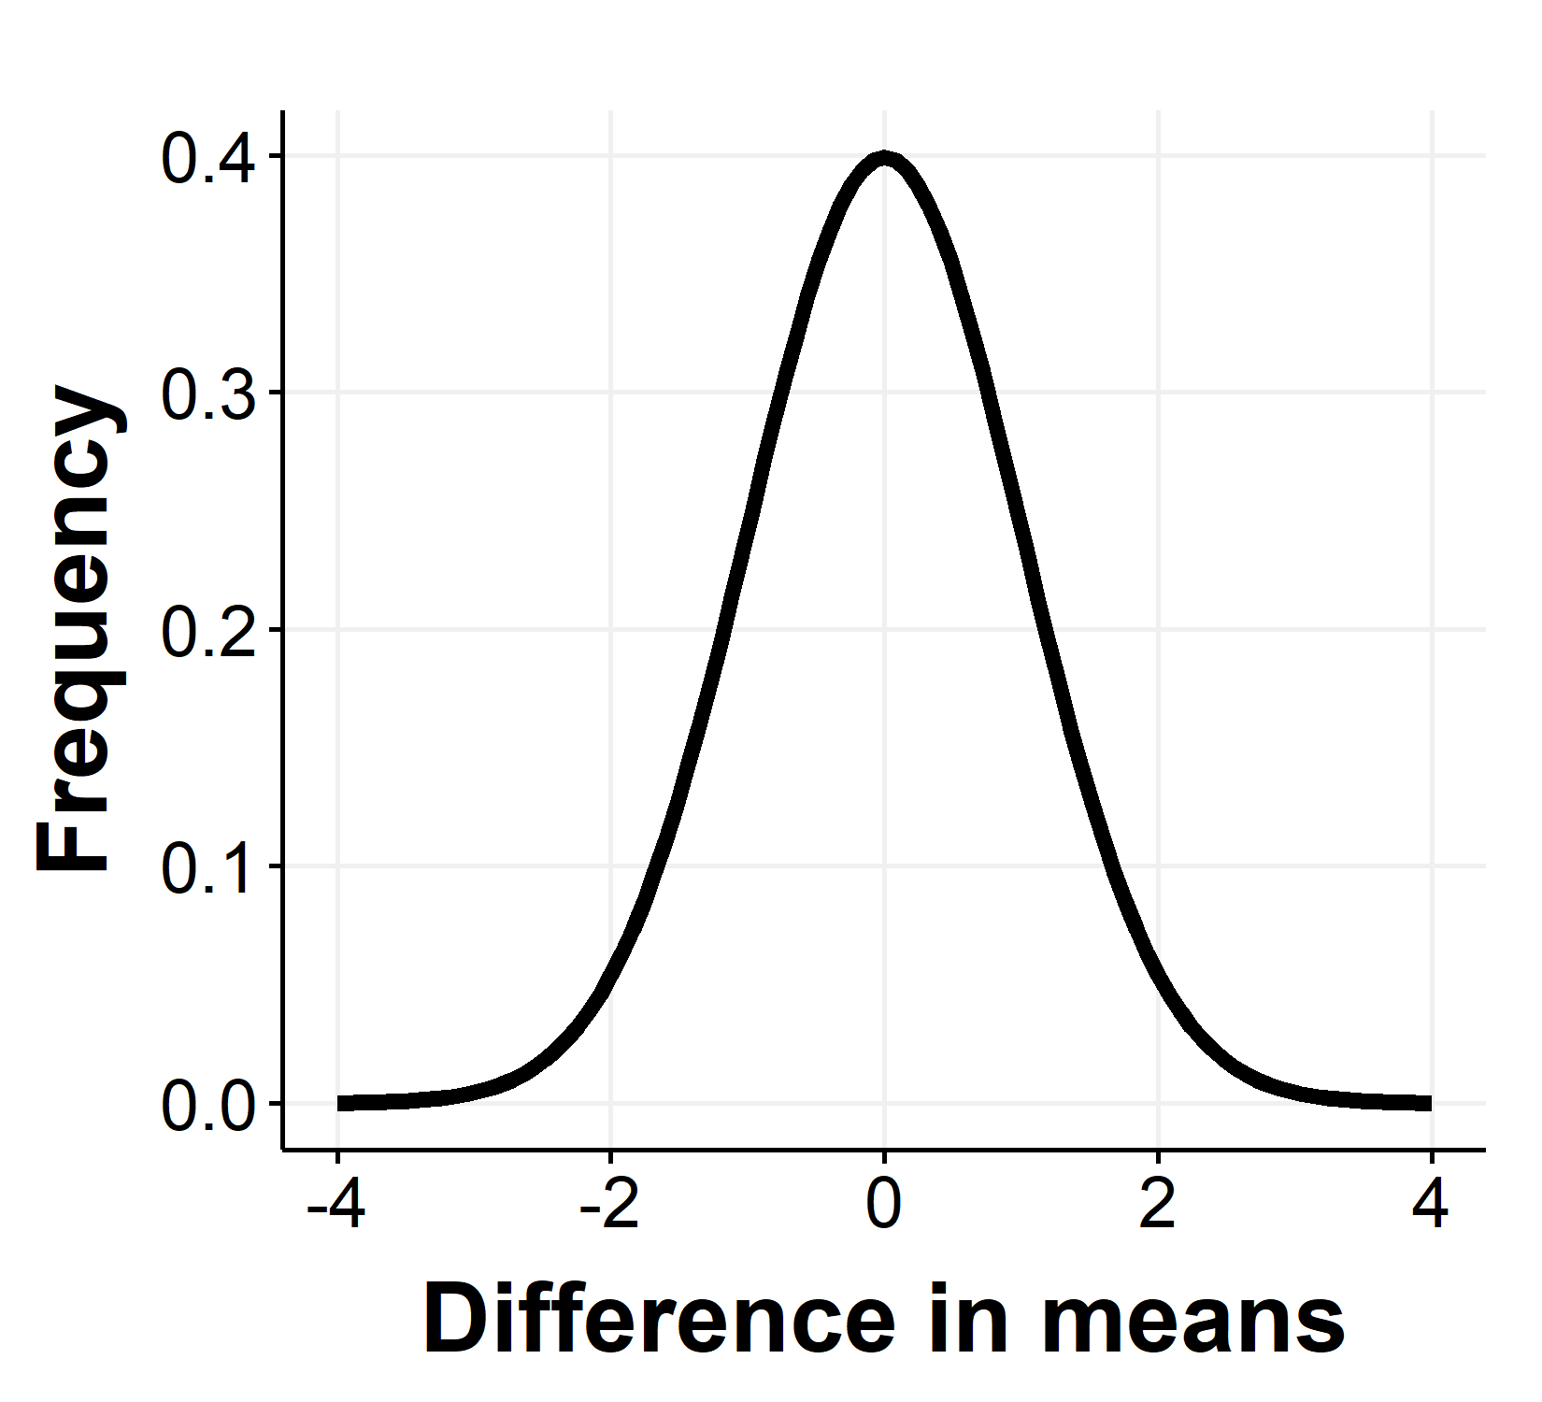
Significance
Null hypothesis: samples belong to the same distribution.
i.e., means of the samples are the equal => difference in means =0.
“Difference in means” belongs to a distribution with mean = 0!
How likely is the difference in means to belong to the Null distribution?
Significance level -> empirical tolerance for deciding belongingness

Slide 26
P-value
Cumulative probability of sampling a point in the null distribution greater than the observed value
Area under the curve denoted by the arrow
If p-value < significance, we reject null hypothesis
If not, we fail to reject null hypothesis
How would you calculate p-value?

Slide 27
Points to ponder
To perform a statistical test, you need a quantity that the null hypothesis talks about (aka the statistic) and the corresponding distribution. What does knowing a distribution entail?
Significance level – the fraction of times we get False positive, i.e., fraction of times we reject the null hypothesis when it is actually true.
Rejecting a null hypothesis only favours the alternative hypothesis, doesn’t prove it. In other words, one has to create the right null hypothesis for conclusively proving your alternative hypothesis
In the difference tests, having low p-value does not mean there is a reasonable difference. A large sample size can give rise to a small p-value too!
Hypothesis testing forms the basis of every statistical model

Slide 28
Exercise: constructing null hypothesis
Increasing culture temperature reduces bacterial growth.
A transcriptional activator increases the levels of my protein
Increasing levels of transcriptional factor increases the levels of protein

Slide 29
Exercise: constructing null hypothesis
Drug A decreases sugar levels in diabetic patients
Drug A decreases sugar levels better than drug B
Incidence rate of cancer is higher in presence of a mutation

Slide 30
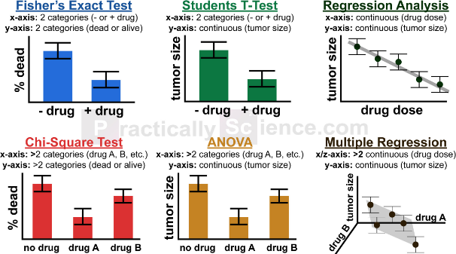
Standard tests – when to use them
https://www.datasciencecentral.com/profiles/blogs/a-plethora-of-original-underused-statistical-tests
The common assumptions: your data is normally distributed, your samples are independently collected

Slide 31
Special mention: t-test
For small sample sizes (biology!)
Does not assume population standard deviation, distribution varies based on sample size
Paired vs unpaired
Two-tailed vs one tailed
How to chose? Based on the hypothesis

Slide 32
Murphy’s law, p-hacking
Murphy’s law: Anything that can happen, will happen. (Can you prove it using ideas of cumulative probability?)
Remember significance – if significance = 5%, there is a 5% chance of false positive
So, if you collect enough number of samples of small size…
Cherry picking, data dredging. Abuse of statistics
One of the key reasons for lack reproducibility in biological research
https://www.vox.com/science-and-health/2018/9/19/17879102/brian-wansink-cornell-food-brand-lab-retractions-jama

Slide 33
Summary
The paradigm of hypothesis testing is prevalent in doing science
There are standard ways to do hypothesis testing, that are often used
Beware of p-hacking
What do you do when the data does not satisfy the assumptions of standard tests? Make your own!

Slide 34
Explaining variation
Domain of multi-variate statistics

Slide 35
What can be the sources of variation?

Slide 36
Possible source of variation
Final OD only
OD at all time points
OD
OD
Noise of various forms
Manual/technical errors
Due to measured/unmeasured factors
temporal dynamics, patterns within variables etc

Slide 37
Statistical models that can explain variation (aka learning)
Dimensionality reduction – more on this tomorrow
PCA
t-SNE
UMAP
Fits
Linear regression – model y with x
Logistic regression
Non-linear regression?
Classification
Mixture models
Clustering models

Slide 38
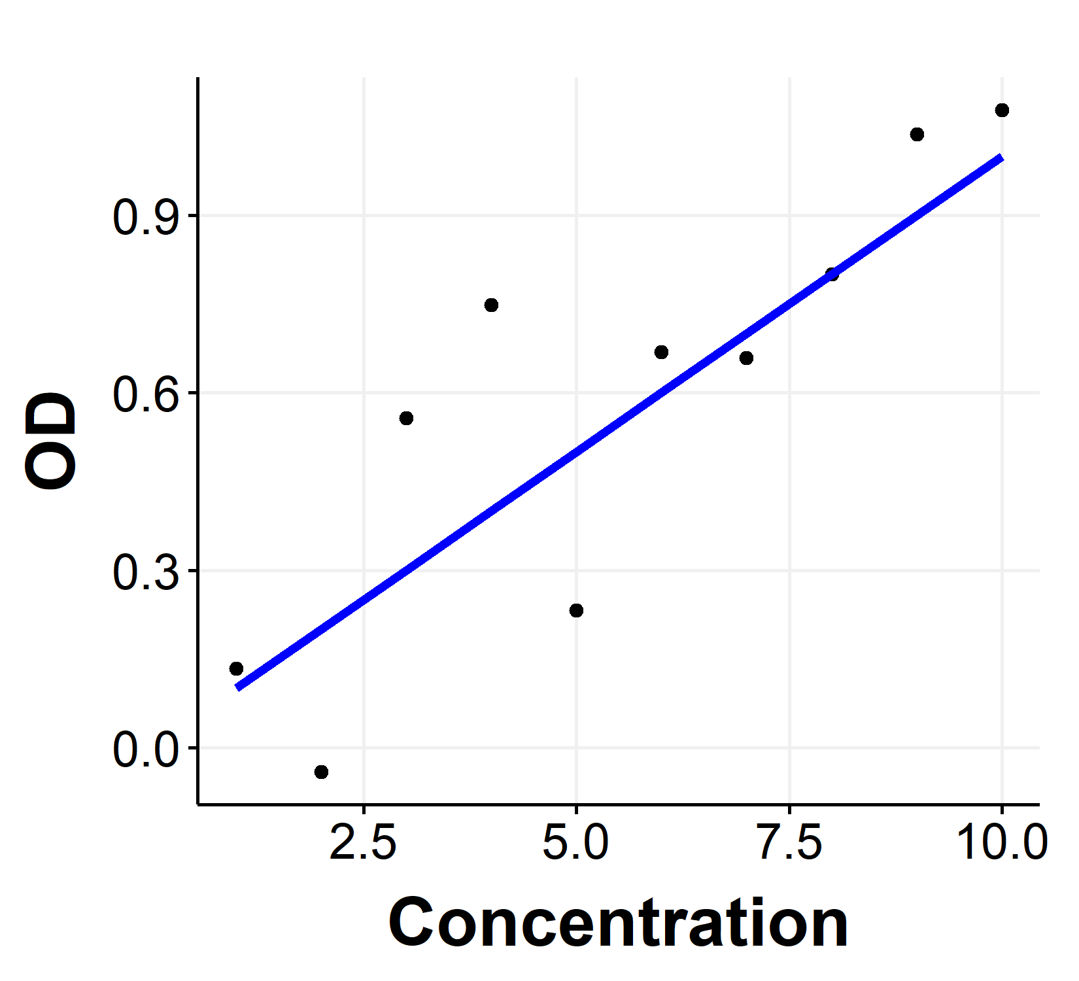
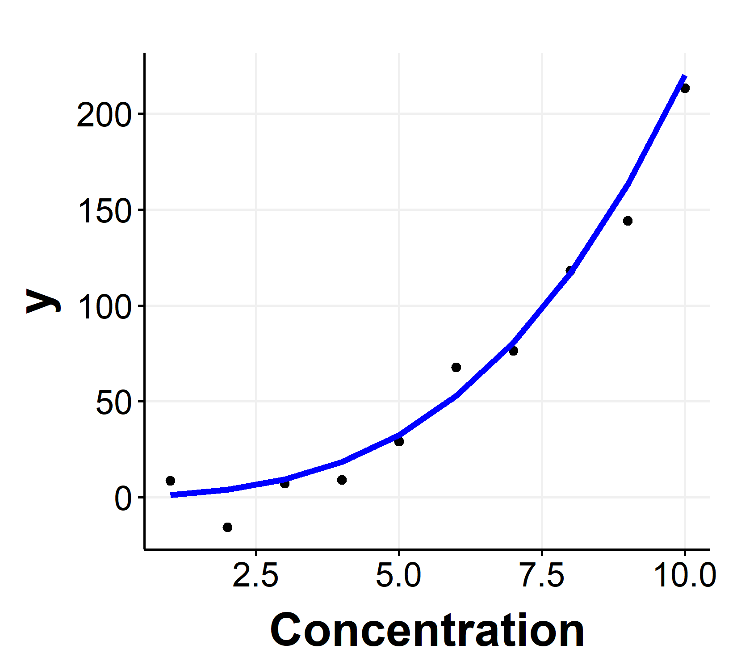
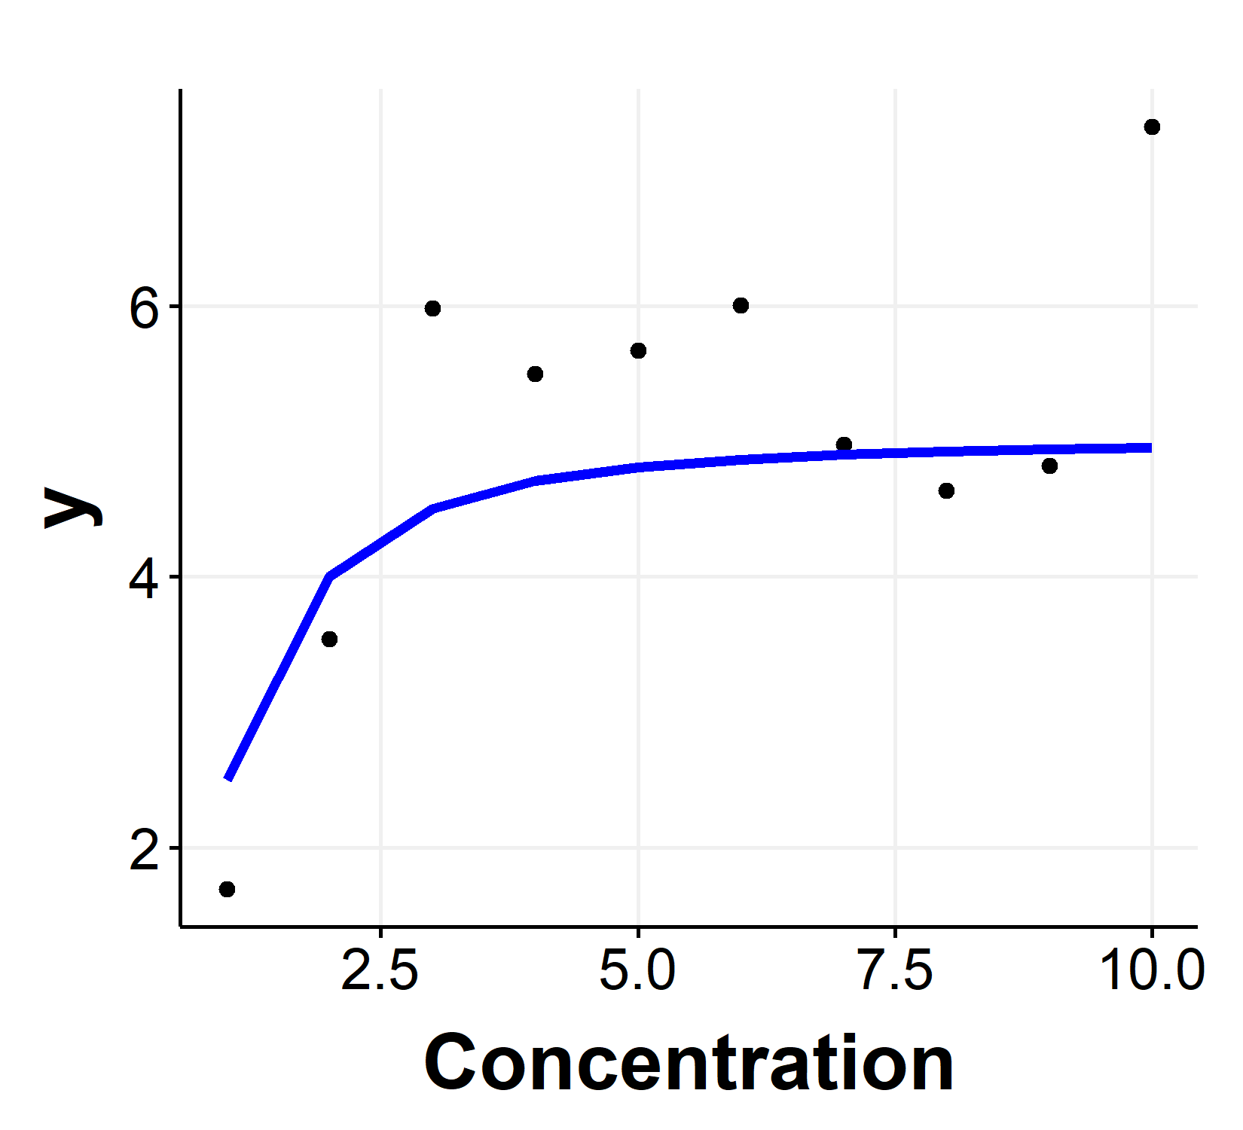



Regression (aka fitting)
Where have you seen linear regression before?
Which of these curves is linear regression?
$$y=0.1∗x^{2}+x+0.2∗x^{3}$$
$$y=5∗x/(1+x)$$
$$y=0.1∗x$$

Slide 39
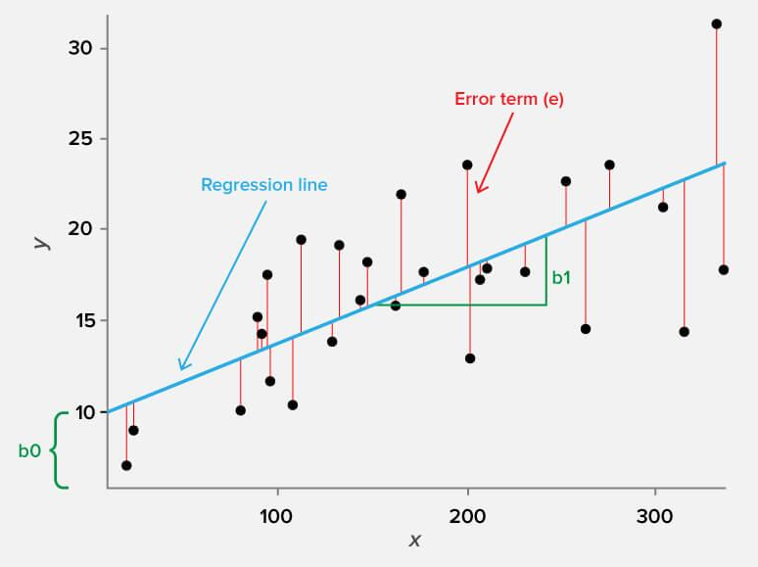
Key concepts
Linear regression – explaining variation in y with variation in x
Linear – in coefficients
Error terms – The most important aspect of regression (or any fit)
R-squared – measure of the amount of variation explained by the regression.
Can you guess the mathematical form?

Slide 40
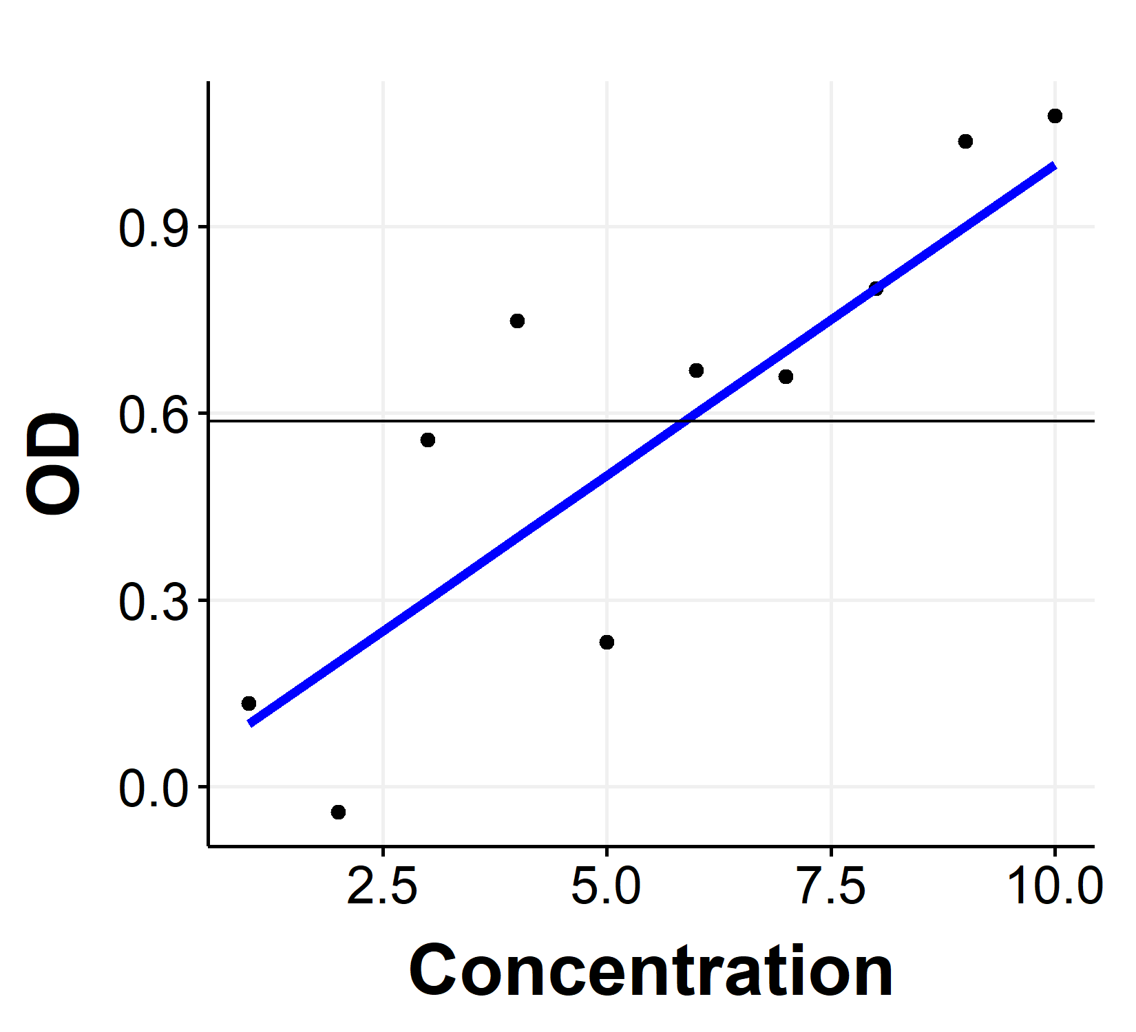
R-squared
R-squared: fraction of variation around mean explained by the regression fit
Variation around mean = 1.2
Variation from the regression line = 0.35
Variation explained by regression = 1.2-0.35/1.2 = 0.71 = R-squared
Therefore, concentration explains 70% of variation in OD
What would statistical significance mean for R-squared?

Slide 41
Statistical significance of Linear regression
T-test of the regression slope : null hypothesis, slope = 0
Statistical test for R^2: null hypothesis, R^2 we obtained is not special
One way to estimate it – generate random R^2 values, get a distribution of random R^2 and calculate the p-value of original R^2 from this distribution.
Another way – F statistic = R^2*(n-1)/k where k is the number of independent variables. We can obtain p-value from F distribution table

Slide 42
Summary
Regression helps us explain the variation in data
Regression can be linear or non-linear, defined by the coefficients
Statistical significance must be calculated

Slide 43
Some useful resources

Slide 44
Statistics
https://www.youtube.com/user/joshstarmer – very intuitive explanation of basic concepts
http://www.wormbook.org/chapters/www_statisticalanalysis/statisticalanalysis.html
https://teaching.statistics-is-awesome.org/all-posts/
Resources on abuse of statistics
https://www.statisticsdonewrong.com/ - Must Read!
https://www.nature.com/collections/qghhqm/
https://influentialpoints.com/Training/statistical_mistakes_in_research_use_and_misuse_of_statistics_in_biology.htm
https://library.stanford.edu/research/data-management-services/share-and-preserve-research-data/domain-specific-data-repositori-3
https://journals.sagepub.com/doi/full/10.1177/0956797611417632
https://www.ncbi.nlm.nih.gov/pmc/articles/PMC6785265/
https://www.ncbi.nlm.nih.gov/pmc/articles/PMC4401313/

Slide 45
R programming
https://www.rstudio.com/resources/cheatsheets/ - beautiful, comprehensive and concise
http://www.sthda.com/english/wiki/ggplot2-essentials - this website has many other resources that are very useful for googling
https://rpubs.com/Koundy/71792 - very nice theme that generates clean plots in ggplot2
https://cran.r-project.org/web/views/ - This is an excellent collection of R packages for various functions.

Slide 46
Data analysis, RNA-seq
https://www.datacamp.com/community/tutorials/pca-analysis-r
https://towardsdatascience.com/dimensionality-reduction-for-data-visualization-pca-vs-tsne-vs-umap-be4aa7b1cb29
https://genomebiology.biomedcentral.com/articles/10.1186/s13059-016-0881-8

